Slide 1
BBC Micro: Bit
Introduction by Aryan Sharma

Slide 2
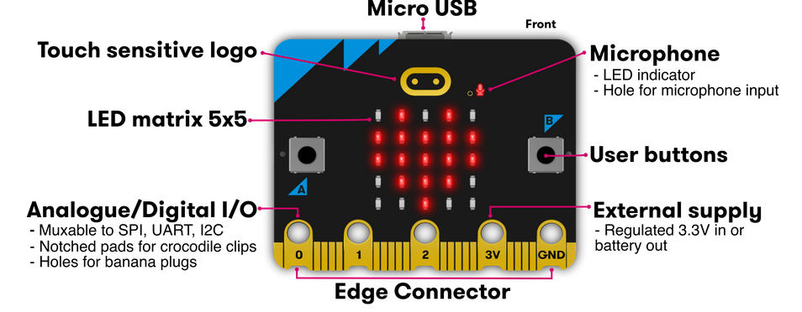
Hardware

Slide 3
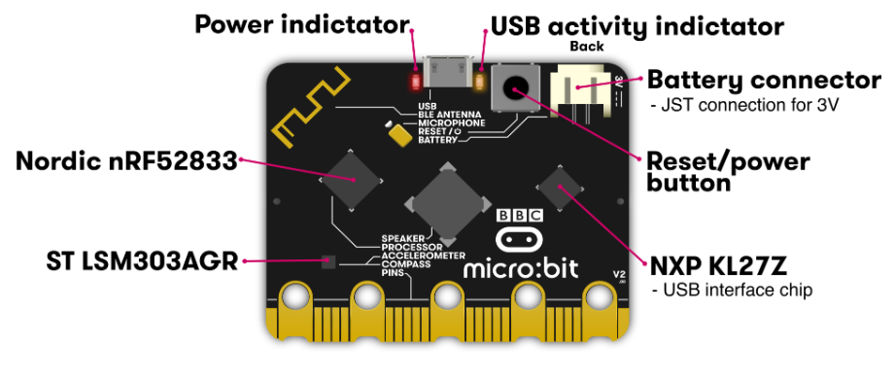
Hardware

Slide 4
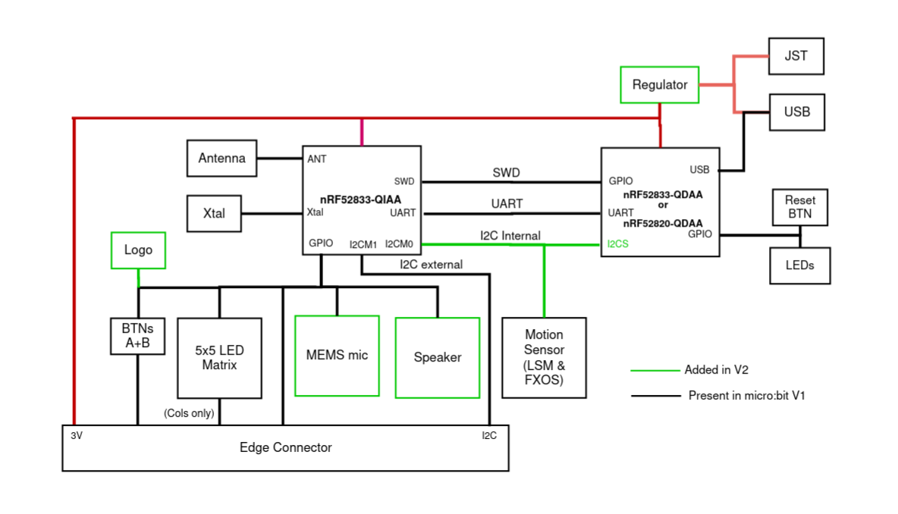
Hardware
NXP KL27Z

Slide 5
MCUs
There are 2 MCUs (microcontroller units) on board.
Nordic nRF52833 -> main MCU , where all the user instructions run.
NXP KL27Z -> interface MCU, which basically helps in flashing the code in the RAM and controls all interactions with USB, including the debugger

Slide 6
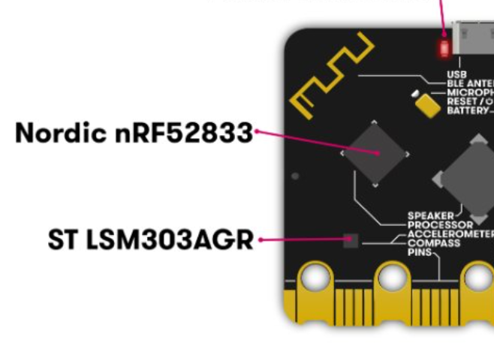
Nordic nRF52
The nRF52833 application processor is where user programs run.
Flash ROM : 512KB
RAM : 128KB
Speed : 64MHz
ISA : ARM-Cortex-V7 instructions
A link to all important instructions : ARMv7-cheat-sheet.pdf

Slide 7
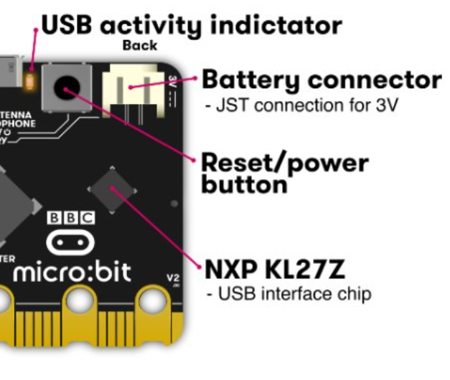
NXP KL27Z
The interface chip handles the USB connection
And is used for flashing new code
Sending and receiving serial data back and forth to your main computer.
Helps in Real-Time Debugging

Slide 8
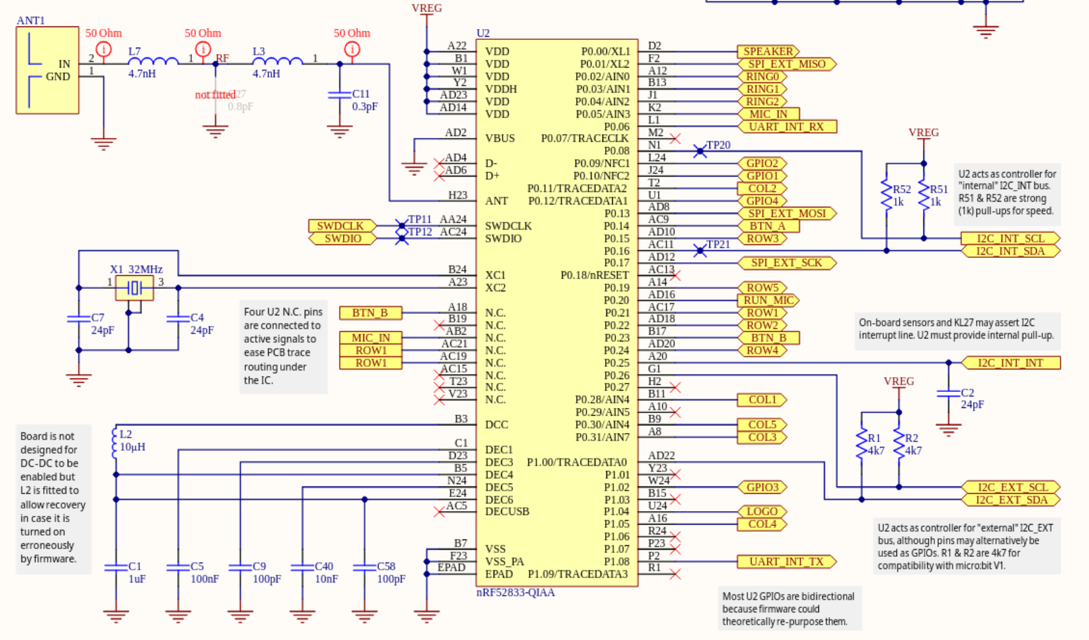
Pin configuration of our Micro:Bit

Slide 9
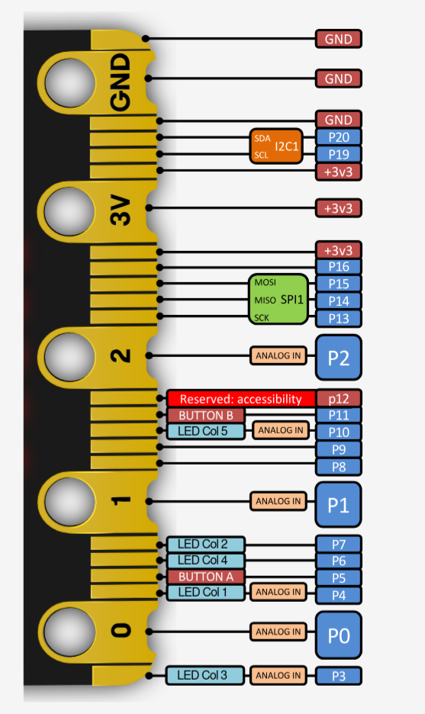
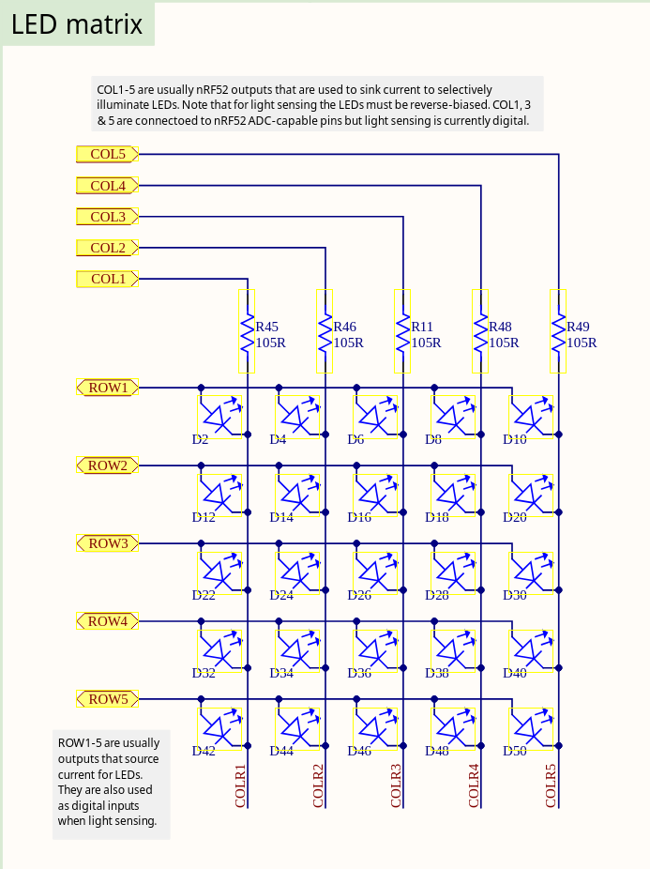
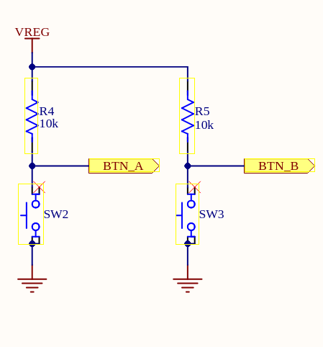
Pin configuration of our Micro:Bit
NOTE:
The buttons are active low and passive high

Slide 10
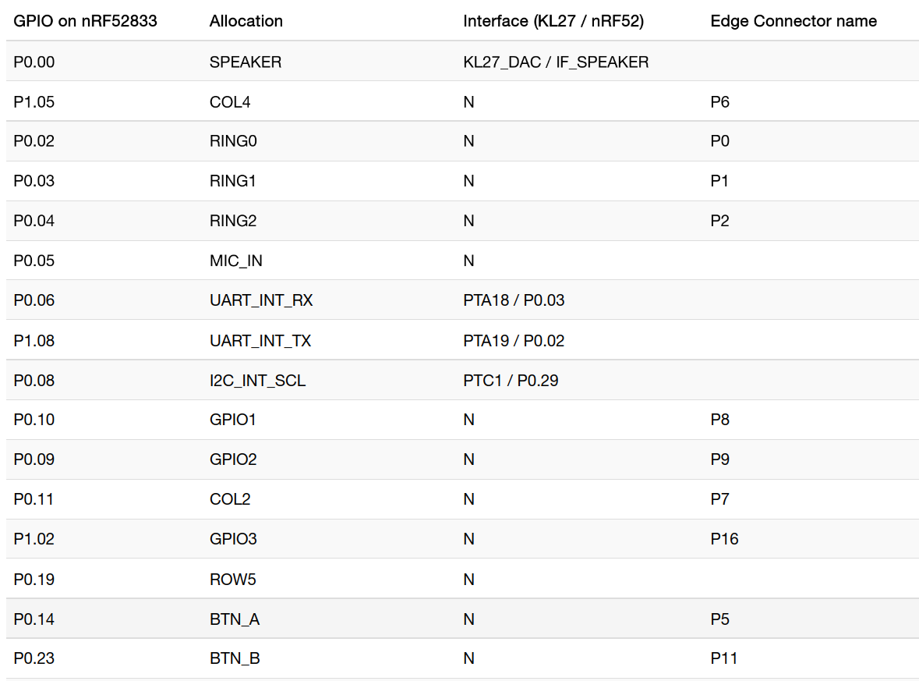
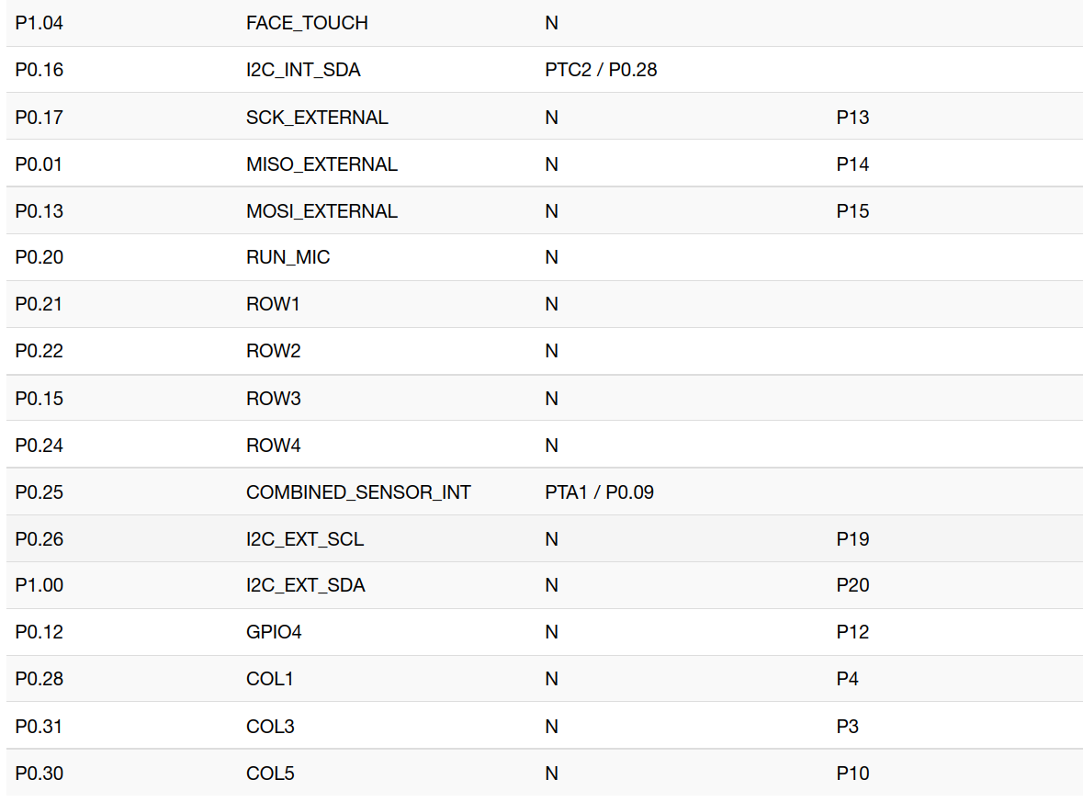
Pin configuration of our Micro:Bit

Slide 11
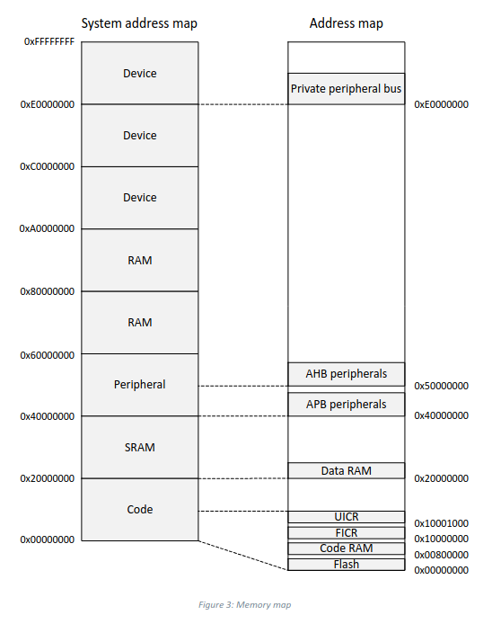
Memory Map
The nRF52833 contains 512 kB of flash memory and 128 kB of RAM that can be used for code and data storage.
The CPU and peripherals with EasyDMA can access memory
EasyDMA is a module implemented by some peripherals to gain direct access to Data RAM.
EasyDMA is not able to access flash
A peripheral can implement multiple EasyDMA instances to provide dedicated channels. For example, for reading and writing of data between the peripheral and RAM.

Slide 12
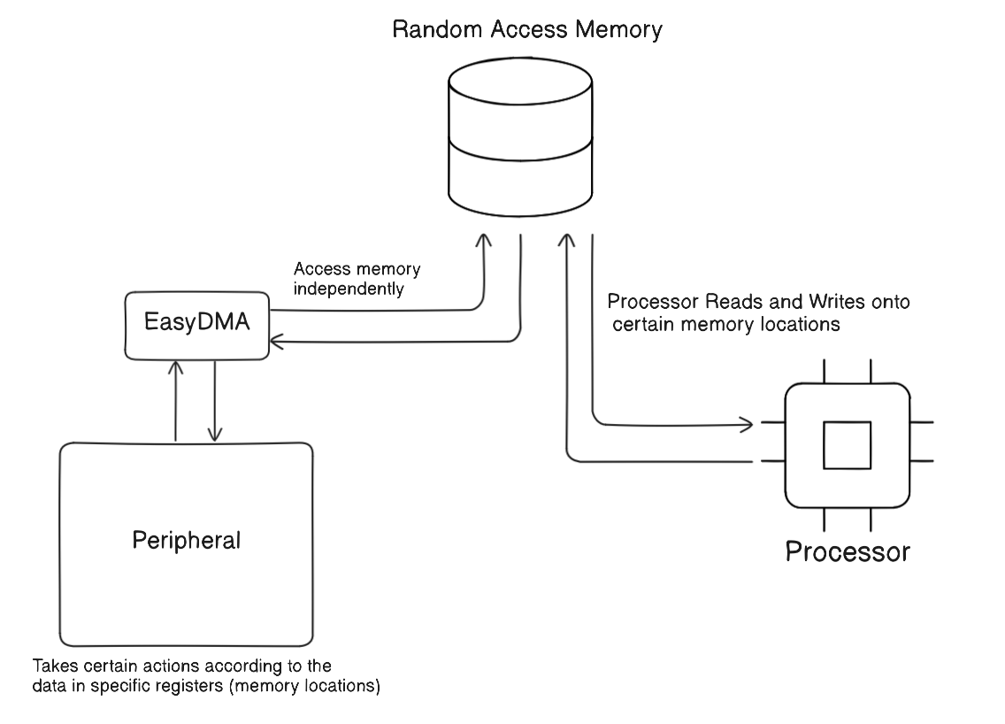
EasyDMA

Slide 13
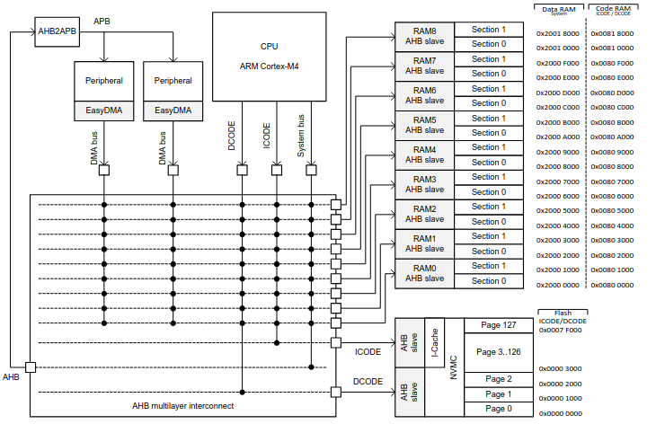
Some Extra Details (optional)

Slide 14
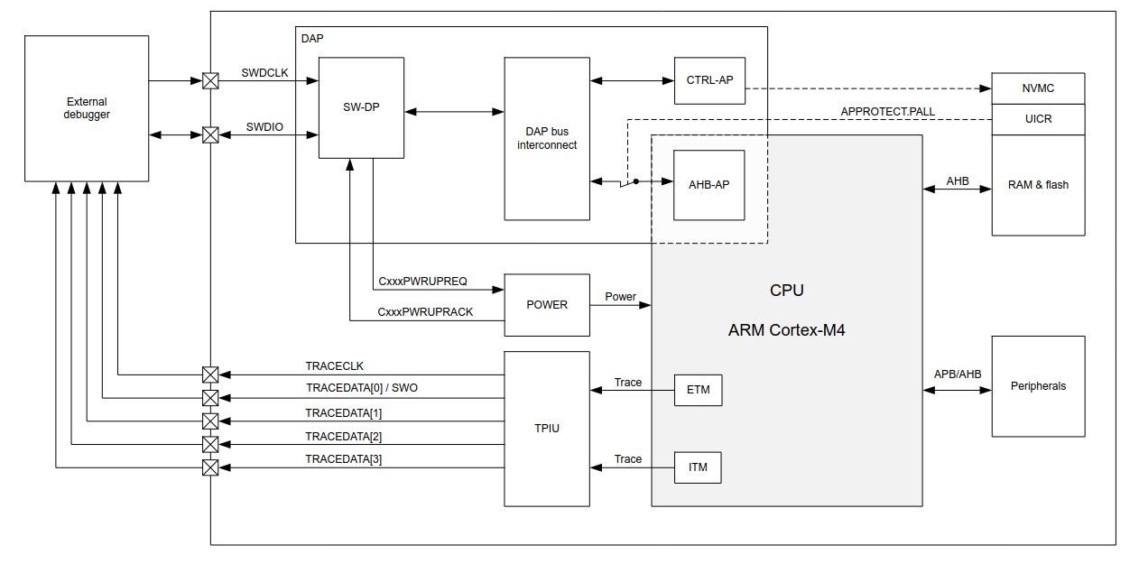
Real-time debug
The nRF52833 supports real-time debugging.
Real-time debugging allows interrupts to execute to completion in real time when breakpoints are set in thread mode or lower priority interrupts.
We will use this feature through our VS code extension

Slide 15
Peripherals
The nRF52833 is loaded with peripherals like:
Comparators
GPIOs (general purpose input output pins)
GPIOTEs (GPIO tasks and events)
PWM (pulse width modulation)
Radio (2.4 GHz)
RNG (Random Number Generator)
RTC (Real Time Counter)
SPI (Serial Peripheral Interface )
Timers
I2C communication module
EasyDMA
*The peripherals in bold are important ones and relatively easy to work with

Slide 16
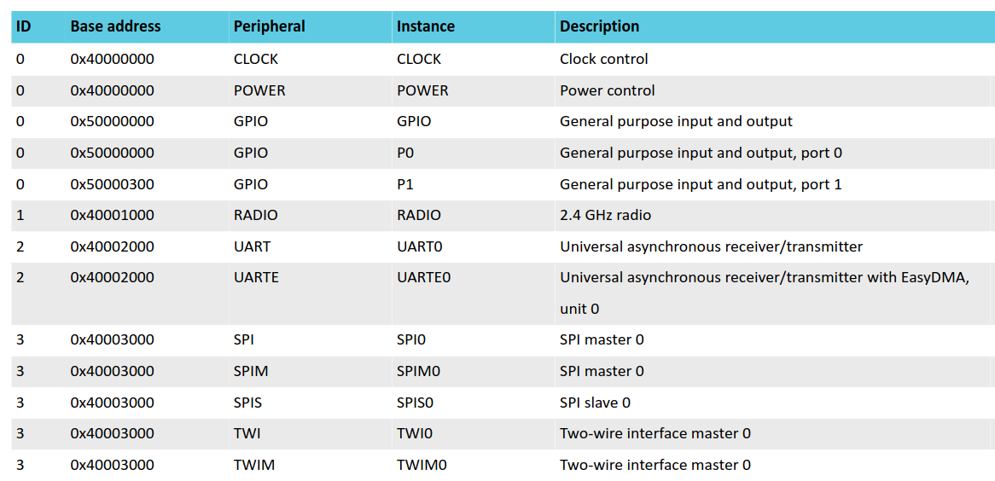
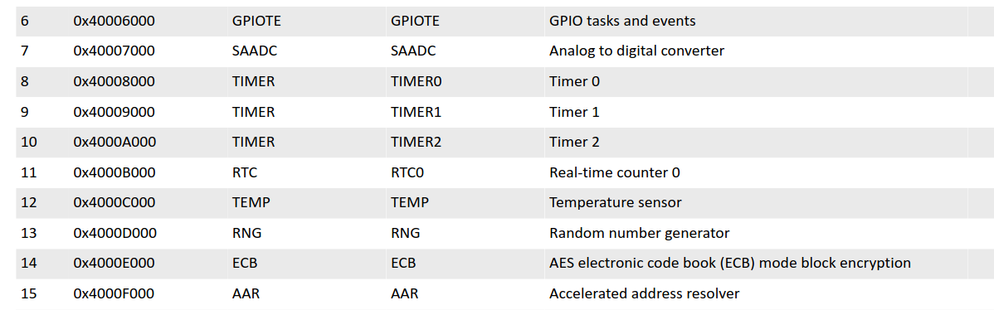
Peripheral interface
Peripherals are controlled by the CPU by writing to configuration registers and task registers.
Peripheral events are indicated to the CPU by event registers and interrupts if they are configured for a given event.
Every peripheral is assigned a fixed block of 0x1000 bytes of address space, which is equal to 1024 x 32 bit registers.
Most peripherals feature an ENABLE register.
The peripheral must be enabled before tasks and events can be used.
Peripherals access the memory using EasyDMA (easy direct memory access)

Slide 17
Tasks and Events
Tasks are used to trigger actions in a peripheral.
A peripheral can implement multiple tasks with each task having a separate register in that peripheral's task register group.
A task is triggered when firmware writes 1 to the task register, or when the peripheral itself or another peripheral toggles the corresponding task signal.
Events are used to notify peripherals and the CPU about events that have happened
For example, a state change in a peripheral.
A peripheral may generate multiple events with each event having a separate register in that peripheral’s event register group.
An event register is only cleared when firmware writes 0 to it.

Slide 18
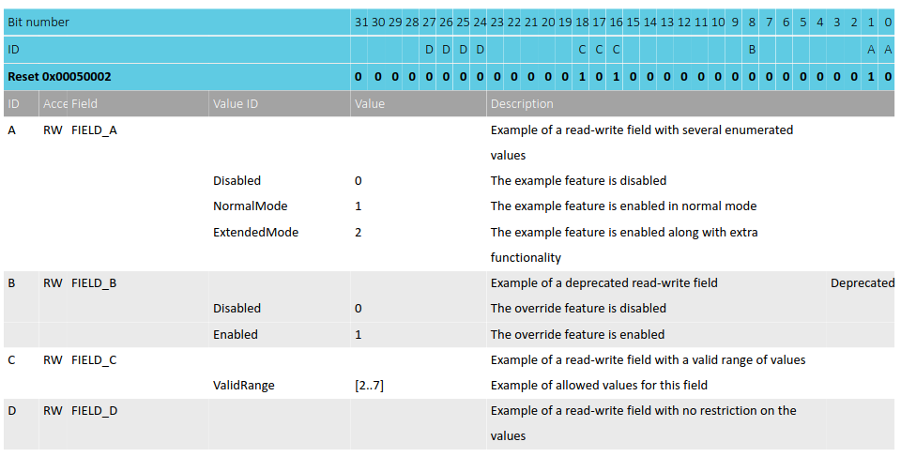
Example : Dummy Peripheral
Lets, say our dummy peripheral has the base address of 0x30004000 and there are several registers that control this peripheral . One of them is shown below:
Real address of this register in memory will be: Base + Offset = 0x30004514
As you can see there are some special bits that hold some important meaning.
We can configure our peripherals using such registers.
The peripheral will continuously access this register using easyDMA and make the necessary changes as soon as the CPU makes changes in the content of the register

Slide 19
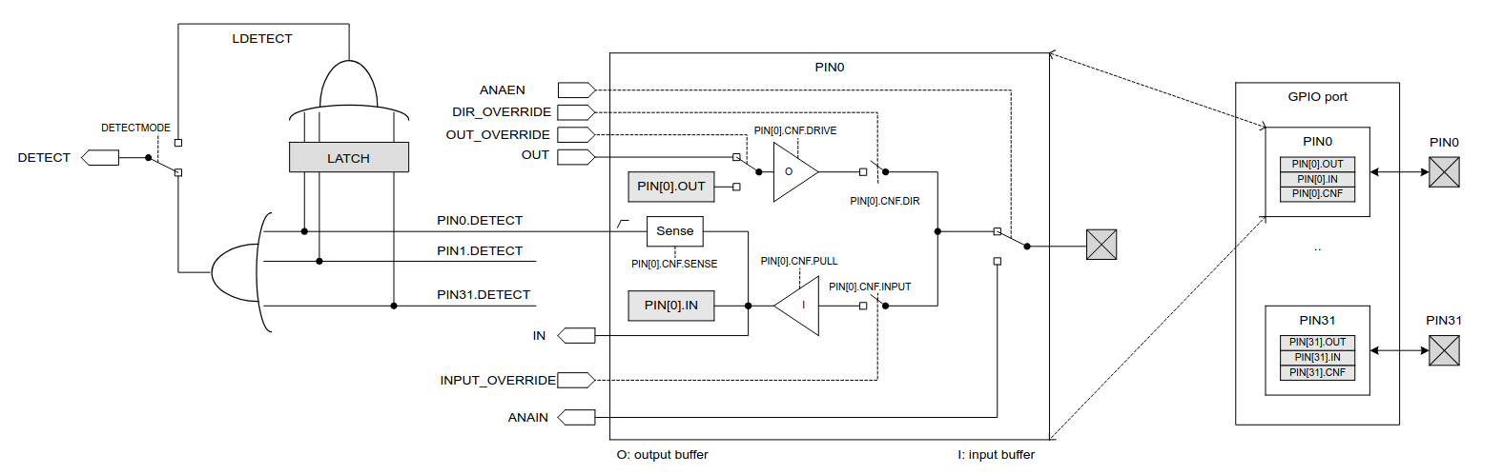
Controlling GPIOS
The general purpose input/output pins (GPIOs) are grouped 2 Ports with each port having up to 32 GPIOs
The GPIO port peripheral implements up to 32 pins, PIN0 through PIN31. Each of these pins can be individually configured in the PIN_CNF[n] registers (n=0..31)

Slide 20
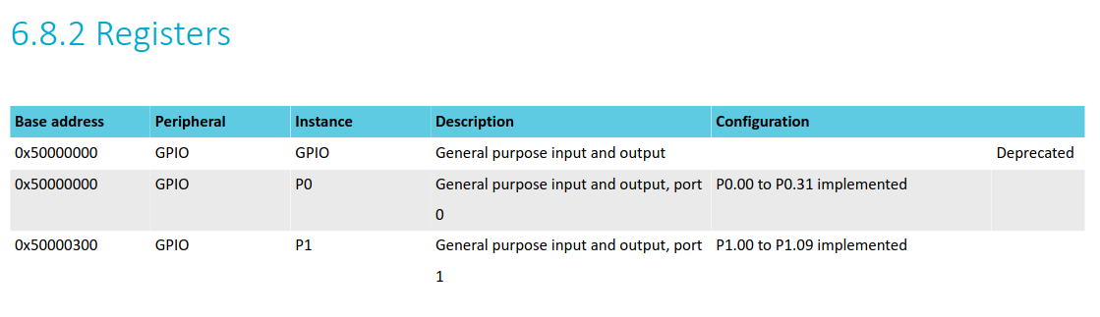
Controlling GPIOS
The general purpose input/output pins (GPIOs) are grouped 2 Ports with each port having up to 32 GPIOs
The GPIO port peripheral implements up to 32 pins, PIN0 through PIN31. Each of these pins can be individually configured in the PIN_CNF[n] registers (n=0..31)

Slide 21
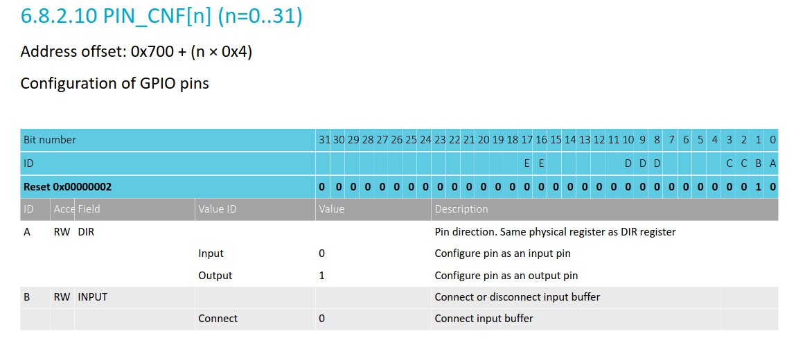
Controlling GPIOS
To start using GPIO pins , we have to first configure them using the CNF Registers.

Slide 22
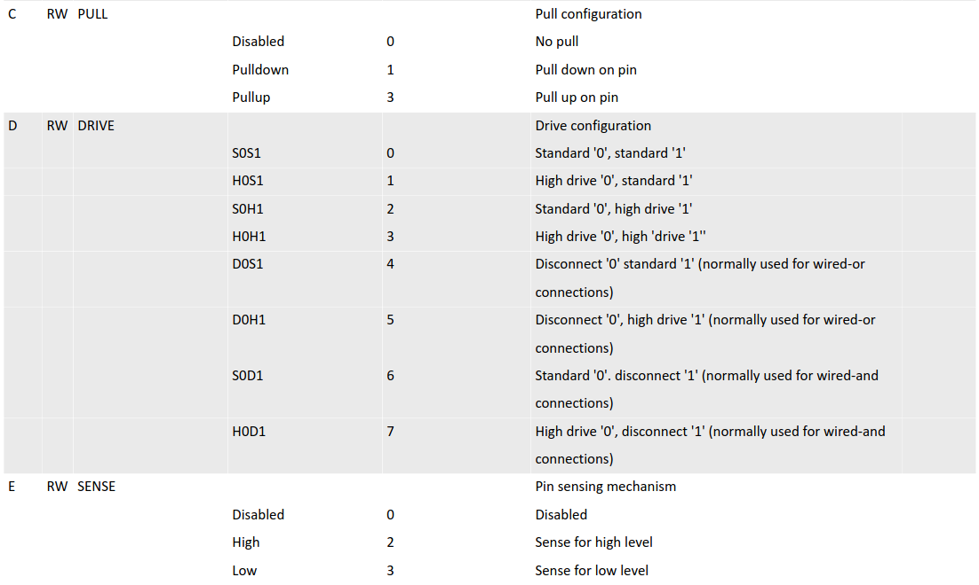
Controlling GPIOS
To start using GPIO pins , we have to first configure them using the CNF Registers.
We can configure PIN 13 of port P0 to be an output pin with pulldown register by writing :
0b0101 to the register at address
= Base + offset
= 0x50000000 + 0x700 + (0x4)*13

Slide 23
Controlling GPIOS
For our purpose option B , D and E are not much useful

Slide 24
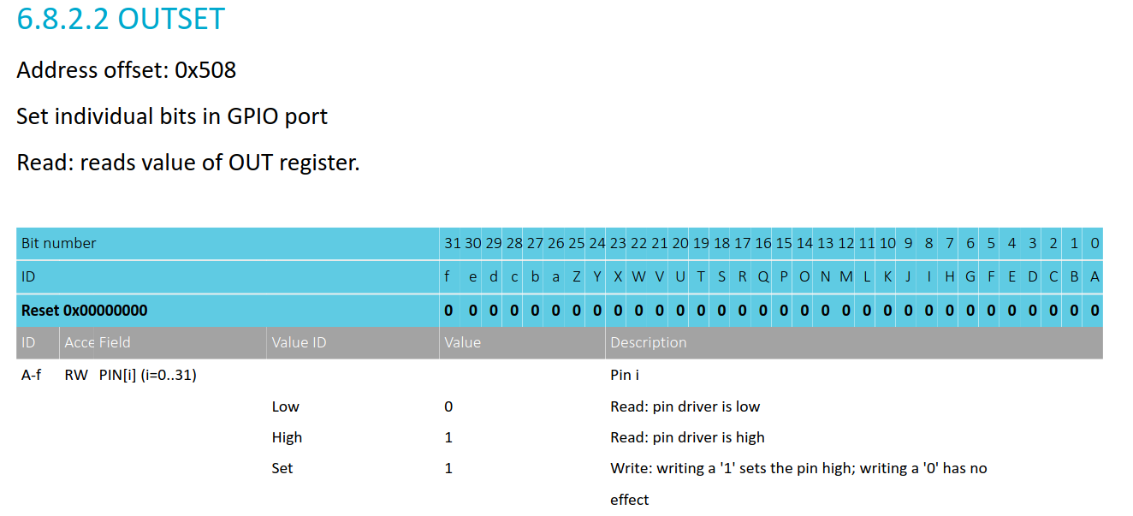
Controlling GPIOS
We have now successfully configured PIN : P0.13
As an output pin with pulldown register.
Now to set the pin HIGH , we need to write to address = Base + offset = 0x50000000 + 0x508
Data to write : 0b00000000000000000010000000000000
As soon as we write this data onto the memory location , the peripheral will access this location using EasyDMA and set the pin HIGH

Slide 25
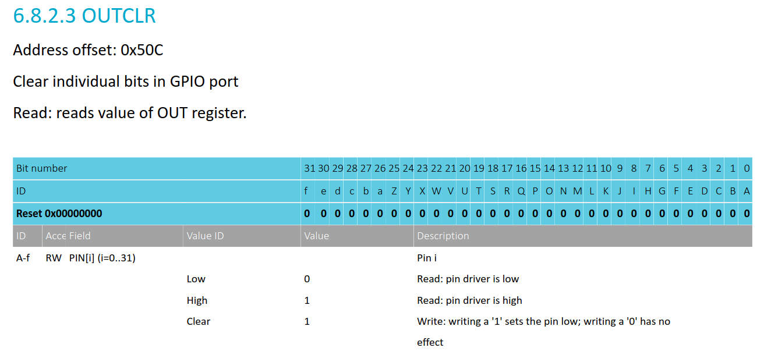
Controlling GPIOS
We have now successfully configured PIN : P0.13
As an output pin with pulldown register.
Now to set the pin LOW, we need to write to address = Base + offset = 0x50000000 + 0x50C
Data to write : 0b00000000000000000010000000000000
As soon as we write this data onto the memory location , the peripheral will access this location using EasyDMA and set the pin LOW

Slide 26
Controlling GPIOS
We have now successfully configured PIN : P0.13
As an output pin with pulldown register.
Now to set the pin LOW, we need to write to address = Base + offset = 0x50000000 + 0x50C
Data to write : 0b00000000000000000010000000000000
As soon as we write this data onto the memory location , the peripheral will access this location using EasyDMA and set the pin LOW

Slide 27
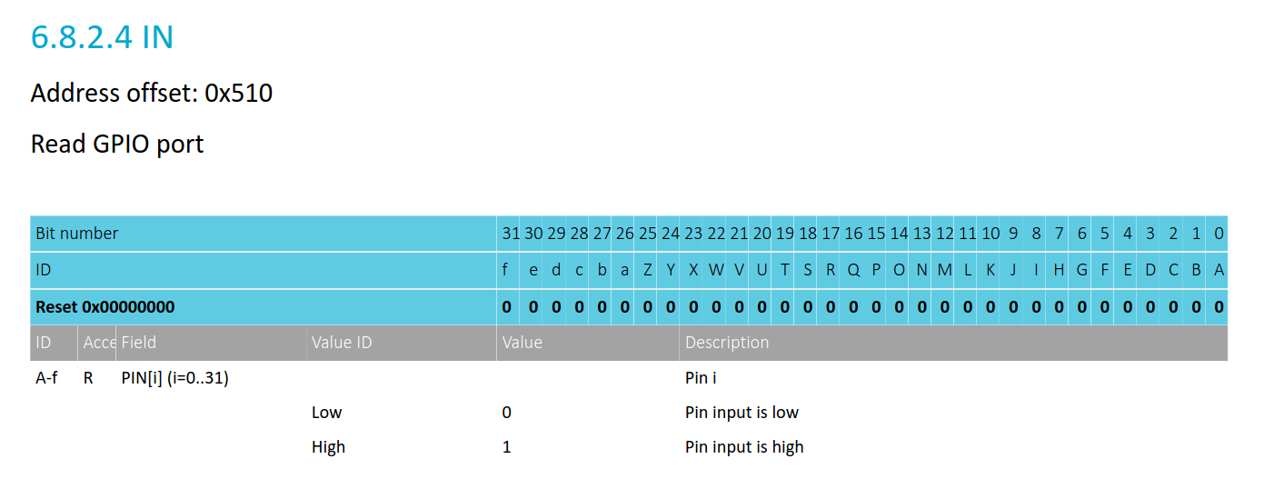
Controlling GPIOS
So far, we have only seen how to control the pins as output.
To take input (maybe from the onboard buttons) we need to configure those pins (as specified in pinout) as output pins.
After that we can simply look at the memory location of = Base addr of port + 0x510
Each of the 32 bits will indicate the logic level at those pins at that moment.
For example , if Bit-9 == 1 then it means pin9 of that port is high .

Slide 28
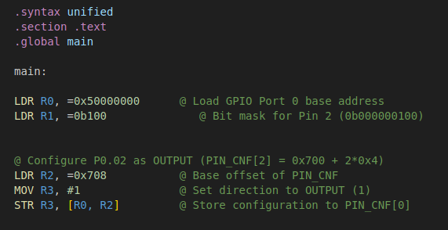
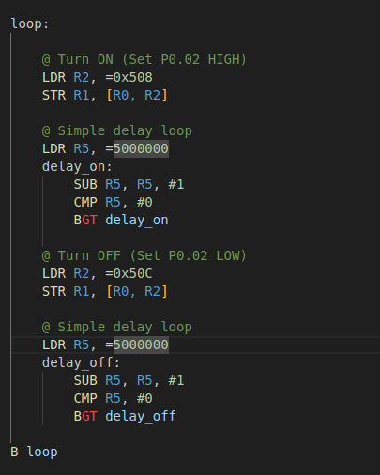
Code for a simple Blink LED program
GPIO P0.02 is connected to RING-0 of the microbit

Slide 29
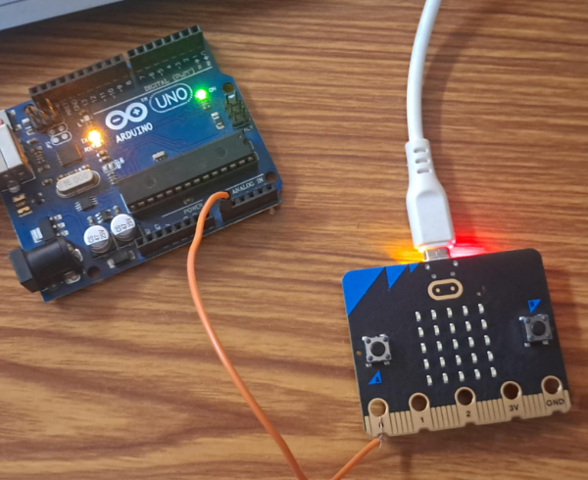
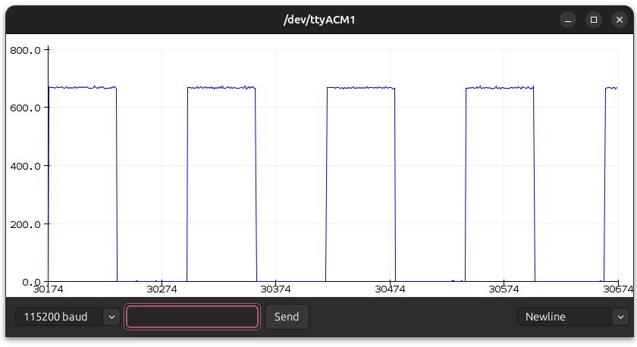
Code for a simple Blink LED program
I plotted the pin output using another microcontroller (Arduino) , and here is the result.
*I only connected the Pin and I was able to measure the voltage because the GND was internally connected through my laptop

Slide 30
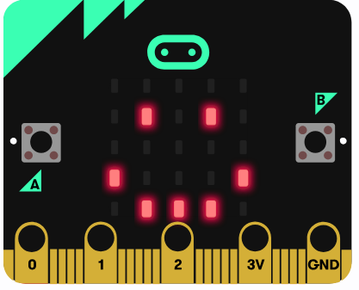
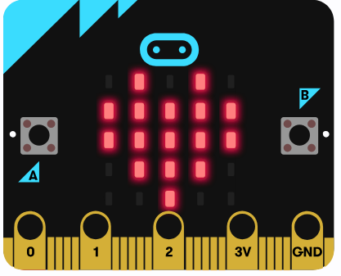
Controlling the LED MATRIX
The display is a 5x5 array of LEDs.

Slide 31
Controlling the LED MATRIX
The 25 LEDs are wired in a row-column configuration to reduce the number of required control pins.
To turn on D4 led , Row1 GPIO must be HIGH and Col2 GPIO should be set to LOW
Now if I want to simultaneously turn on D20 , I will set Row2 to be HIGH and COL5 to be LOW
Can you find the problem with this ???

Slide 32
Controlling the LED MATRIX
The 25 LEDs are wired in a row-column configuration to reduce the number of required control pins.
To turn on D4 led , Row1 GPIO must be HIGH and Col2 GPIO should be set to LOW
Now if I want to simultaneously turn on D20 , I will set Row2 to be HIGH and COL5 to be LOW
Can you find the problem with this ???
D14 will also get turned on !

Slide 33
Controlling the LED MATRIX
You cannot turn on two LEDs in different rows and columns at the same time because they will create an unintended path due to shared rows and columns. This is called ghosting or cross-activation.
To display multiple LEDs in different rows and columns, we will use a technique called multiplexing or frame refreshing.
A full LED pattern is divided into separate row-wise frames.
Each frame represents one active row at a time.
After a very short delay , we will deactivate the row and activate the next one.
Now if we do it fast enough , our human eyes will perceive it as if multiple LEDs across different rows and columns are ON simultaneously.
Example of displaying "A" in the subsequent slides.

Slide 34
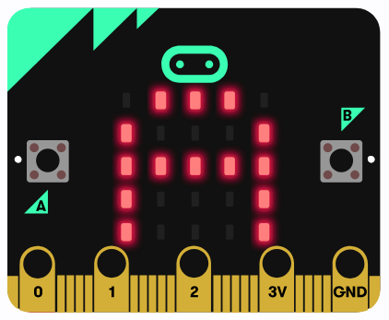
Controlling the LED MATRIX

Slide 35
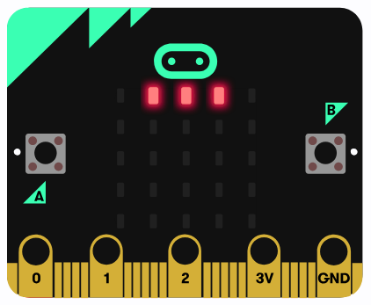
Controlling the LED MATRIX

Slide 36
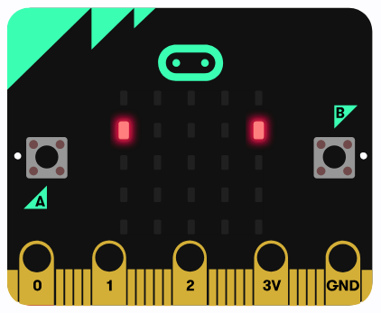
Controlling the LED MATRIX

Slide 37
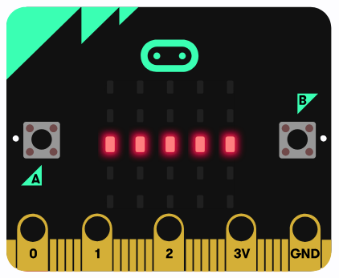
Controlling the LED MATRIX

Slide 38
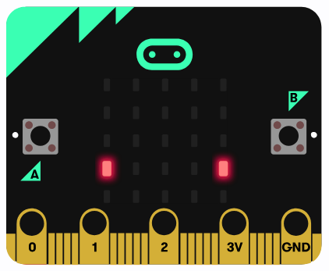
Controlling the LED MATRIX

Slide 39
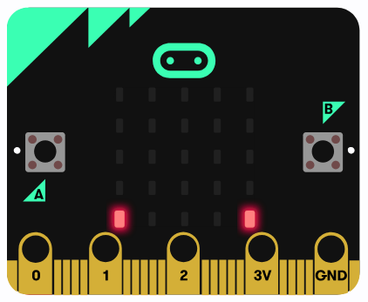
Controlling the LED MATRIX

Slide 40
Controlling the LED MATRIX

Slide 41
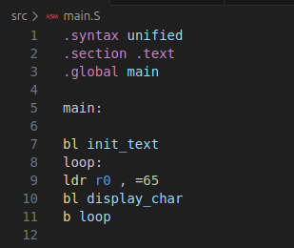
Library to do the same.
There's a library called Led.S, made by ANU-COMP2300 students, that lets you control specific LEDs in a 5x5 matrix.
You can find it in workfolder/lib.
Using that, I made another library called text.S to make things easier.
Just load the ASCII value (capital letters or numbers) into R0 and call the function—it’ll handle the multiplexing for one cycle.
If you want the character to stay on the screen, just keep calling it in a loop.
bl init_text Initializes the Row 1-5 and Col 1-5 Pins
bl display_char takes the value in R0 and displays the character.

Slide 42
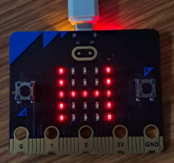
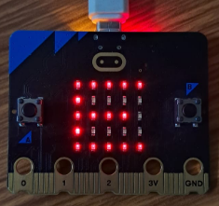
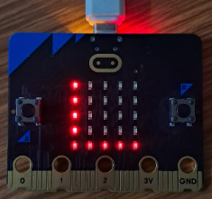
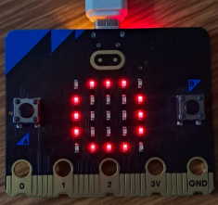
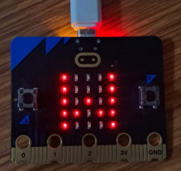
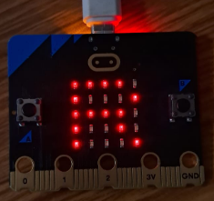
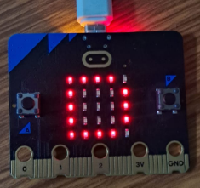
Library to do the same.

Slide 43
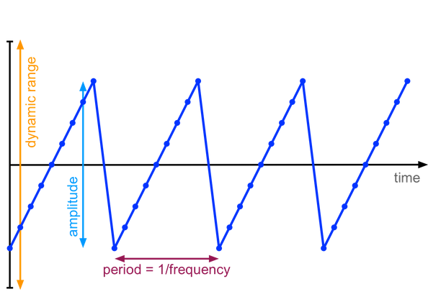
Controlling Speakers.
There is a cool library by Benjamin Gray ANU which lets you play out a certain sequence of audio sample.
audio_init: this function sets up sound on the microbit which basically means setting the speaker (GPIO P0.00) to output, enabling PWM (pulse width modulation) on this pin, and setting up some buffers and timers to ensure smooth audio.
audio_play_sample: this function takes r0 as an argument. It takes the lowest 8 bits of r0 and treats them as the next audio sample to play.
In the image, the little points each indicate a sample, that is a number stored in r0.
The x-axis is time, and the y-axis is the number in r0.

Slide 44
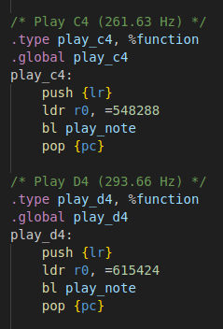
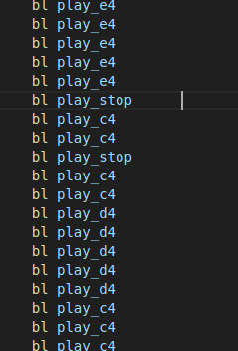
Controlling Speakers.
Using this library , I make another library through which you can play specific notes.
Then we can literally play any song / tune that we want.
There are more functions for all major notes.

Slide 45
Other Cool Stuff
This was just a glimpse of what can be done.
I did more complex things like:
Using I2C protocol to talk to different sensors and retrieving data from them.
Like Magnetometer and Accelerometer
Using in-chip temperature sensor to get the current temperature (Although it might be slightly higher than real surrounding temperatures because of the heat produced by the MCU itself)
Handling Interrupts using GPIOTE module.

Slide 46
References
ARMv7-cheat-sheet.pdf (All important ISA instructions)
ARMv7-M-architecture-reference-manual.pdf (Detailed ARM architecture - optional)
lsm303agr_magetometerAndAccelerometer.pdf (On board Magnetometer and Accelerometer Datasheet)
MicroBit_schematic.PDF ( Micro:Bit official schematic )
nRF52833.pdf ( Main MCU Datasheet)
https://tech.microbit.org/ (Official Website for technical details regarding Micro:Bit)

Slide 47
Thank You!

